Slide 1
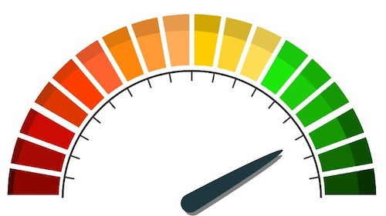
Load And Stress Testing

Slide 2

What about
non-functional tests?

Slide 3

The problem
In our tests we don’t test the system performance. Its mean we don’t have a clue what will happen to our application under different circumstances and workloads.
We don’t know how much time the system will response with a lot users in parallel? Will it going to crash?
What will happen during attack?

Slide 4
The solution
Use performance testing!
Throughput. How many units of data a system processes over a specified time.
Memory. The working storage space available to a processor or workload.
Response time. The amount of time elapsed between a user-entered request and the start of a system's response to that request.
Bandwidth. The volume of data per second that can move between workloads, usually across a network.
Central processing unit (CPU) interrupts per second. The number of hardware interrupts a process receives per second.
Average latency. Also called wait time, a measure of the time it takes to receive the first byte after sending a request.
Average load time. The average time it takes for every request to be delivered.
Peak response time. The longest time frame it takes to fulfill a request.
Error rate. Percentage of requests that result in an error compared to all other requests.
Disk time. Time it takes for a disk to execute a read or write request.
Session amounts. The maximum number of active sessions that can be open at one time.

Slide 5
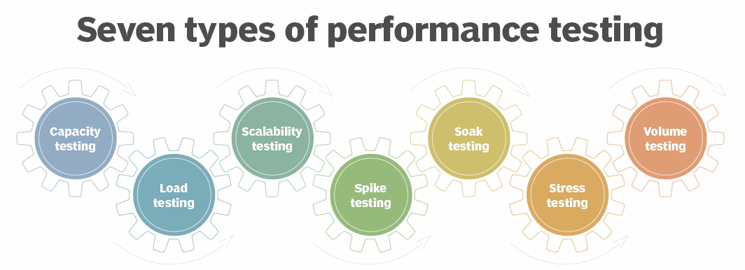
Load testing involves testing software’s performance with a specified load to understand how it behaves under expected or heavy usage. It’s a type of performance test that investigates the speed, scalability, and reliability of a system.
places a system under higher-than-expected traffic loads so developers can see how well the system works above its expected capacity limits.

Slide 6
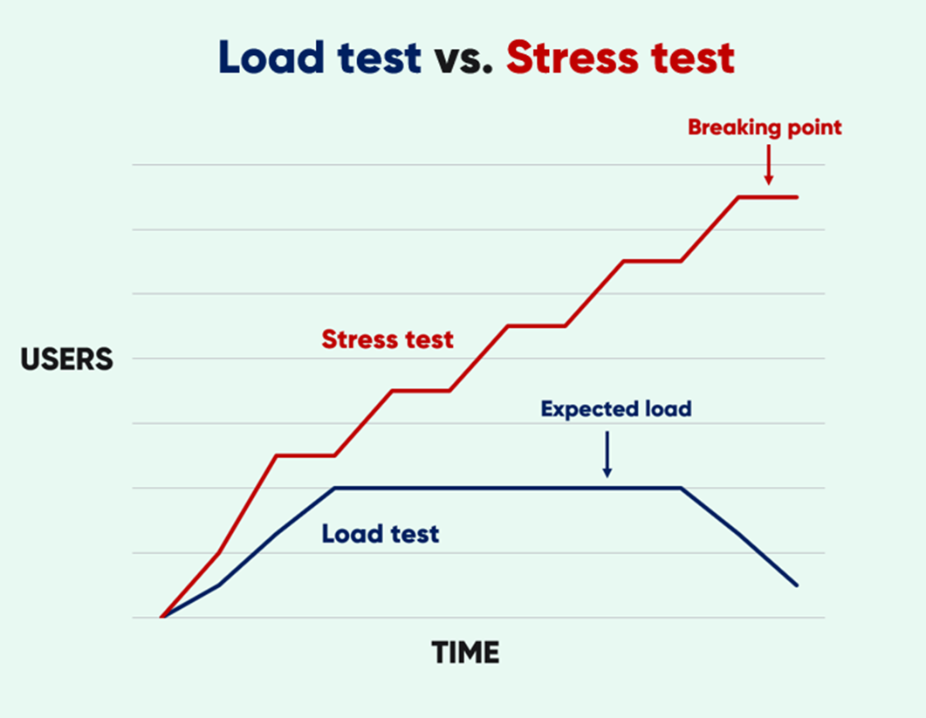
Stress Test
places a system under higher-than-expected traffic loads so developers can see how well the system works above its expected capacity limits.
It is better to be prepared for extreme conditions!
To check whether the system works under abnormal conditions.
Displaying appropriate error message when the system is under stress.
System failure under extreme conditions could result in enormous revenue loss.
Load Test
In the load testing process, an organization simulates the expected number of concurrent users and transactions over a duration of time to verify expected response times and locate bottlenecks.
Performance bottlenecks identification before production
Improves the scalability of the system
Minimize risk related to system downtime
Reduced costs of failure
Increase customer satisfaction
Tests Result And Purpose

Slide 7

Why Not AcceptanceTest or UnitTest?
While acceptance tests focus on validating functional requirements, load tests and stress tests focus on evaluating the system's performance and stability under different conditions.
The current testing methods lack the ability to simulate extended periods of operation under heavy loads and assess performance continuously.
They only provide a pass or fail indication without providing detailed information.
Furthermore, they do not allow for identifying vulnerabilities within the system and simulating attacks or extreme loads.
The current tests focus on isolated sections of the code instead of testing the entire system's performance under normal or extreme loads.

Slide 8
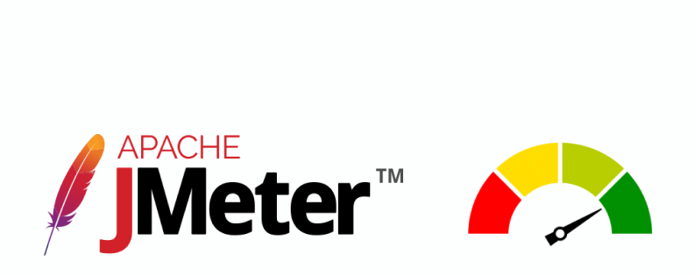
We will use the must common application
JMeter allows you to simulate a large number of concurrent users accessing your application
JMeter provides a user-friendly GUI for creating test plans.
JMeter is open-source software with a large and active community of users and contributors.
It helps identify bottlenecks and limitations in a system's resources.
Link for download: https://jmeter.apache.org/download_jmeter.cgi

Slide 9
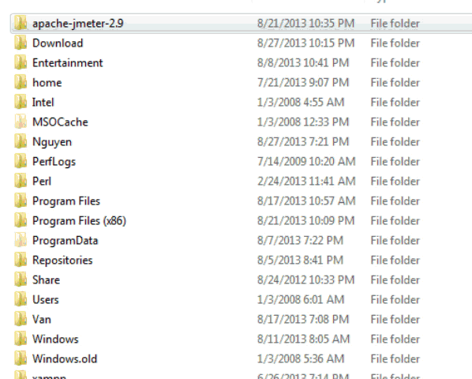

Slide 10


Slide 11

Identifying System Bottlenecks with JMeter
Benefits:
JMeter uncovers limitations on system resources.
Provides insights into performance bottlenecks and their causes.
Enables optimization efforts for improved system performance.
Simulate real-world scenarios and increasing loads using JMeter.
Measure response time, throughput, error rates, and resource utilization with JMeter. Analyze the performance help to identify bottlenecks.
Address identified bottlenecks and validate improvements with JMeter.
Regularly monitor performance to detect new bottlenecks and optimize the system.

Slide 12

Collection of Test Scenarios for Stress and Load Testing of “Sadna Express”

Slide 13
Concurrent User Load:
Simulate a high number of concurrent users accessing the trading system platform.
Measure the system's response time and throughput under heavy user load.
Search Functionality Stress:
Perform repeated searches with varying search parameters and load.
Test the system's ability to handle a large volume of search requests.
Product Listing and Update Load:
Simulate a high number of store managers adding and updating products.
Measure the system's performance in handling simultaneous product management operations.
Shopping Cart Load:
Simulate multiple users adding, updating, and removing items from their shopping carts simultaneously.
Test the system's ability to handle high loads on shopping cart operations.
Checkout Process Stress:
Simulate a large number of users going through the checkout process concurrently.
Measure the system's performance in handling simultaneous checkout operations.
Bidding Load:
Simulate heavy loads on bidding activities.
Test the system's ability to handle high volumes of real-time auction interactions.
Open store Load:
Simulate multiple sellers opening stores simultaneously.
Testing the system's ability to handle concurrent store creation processes.
Purchase Testing Load:
Simulate multiple users making purchases concurrently.
Measure the system’s .
Test the system's performance in processing transactions and order fulfillment.

